Slide 1
SUPER RESOLUTION USING GENERATIVE ADVERSARIAL NETWORKS
Hemanth Kongara

Slide 2
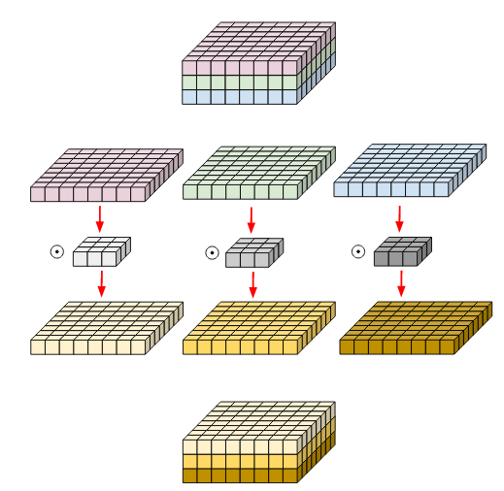
Background
Super-Resolution is to generate high resolution images from low resolution images.
In 2019, Galteri et al. presented a work for generating images from low resolution compressed videos by replacing standard residual blocks with bottleneck depth-separable convolutions blocks in generator network
“A Fast Deep Learning Model to Up sample Low Resolution Videos to High Resolution at 30fps” by Hasnain Raz implemented Galteri et.al idea for super resolution using perceptual loss for generator

Slide 3
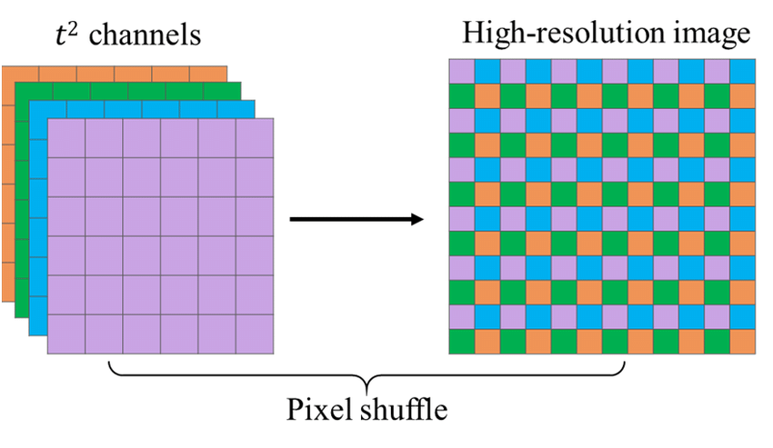
Proposed Approach
The discriminator in Hasnain Raz work uses convolution blocks.
I proposed a modified Fast SR-Gan with discriminator having the same configuration as generator with an extra layer for validity using sigmoid
Hasnain Raz work uses bilinear up sampling in generator
The outputs using bilinear up sampling is compared with pixel shuffle up sampling.
Pixel Shuffle is an operation used in super-resolution models to implement efficient sub-pixel convolutions with a stride of 1/r. Specifically it rearranges elements in a tensor of shape (∗,C×r²,H,W) to a tensor of shape (∗,C,H×r,W×r).

Slide 4
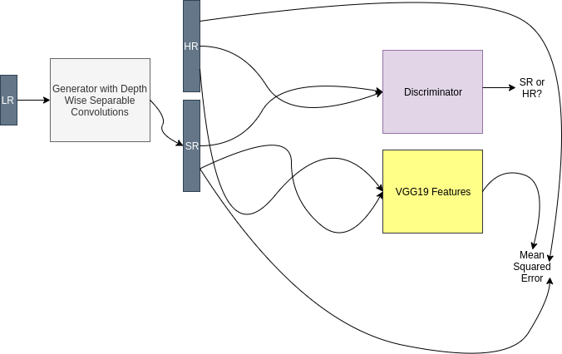
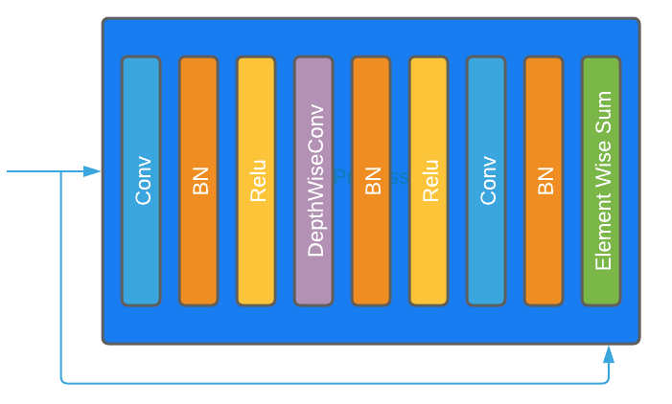
Technical details
DIV2K bicubic dataset was used in all training experiments.
It contains 800 training and 100 validation images both in low and high resolution.
Pretraining is done using MSE loss
Used VGG 19 feature before 5th max - pooling layer and obtained by 4th convolution for perceptual loss
﻿Generator perceptual loss = content loss ( using VGG features) + (10^-3*adversarial loss) + MSE loss

Slide 5
Contributions (Novelty)
Proposed a modified Fast SR-GAN with different discriminator
Compared the results of modified Fast SR-Gan with Fast SR-Gan and SR-Gan
Compared the results of Fast SR-Gan using bilinear up sampling with Fast SR-Gan using pixel shuffle up sampling

Slide 6
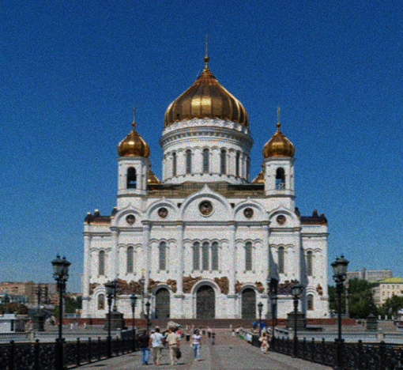
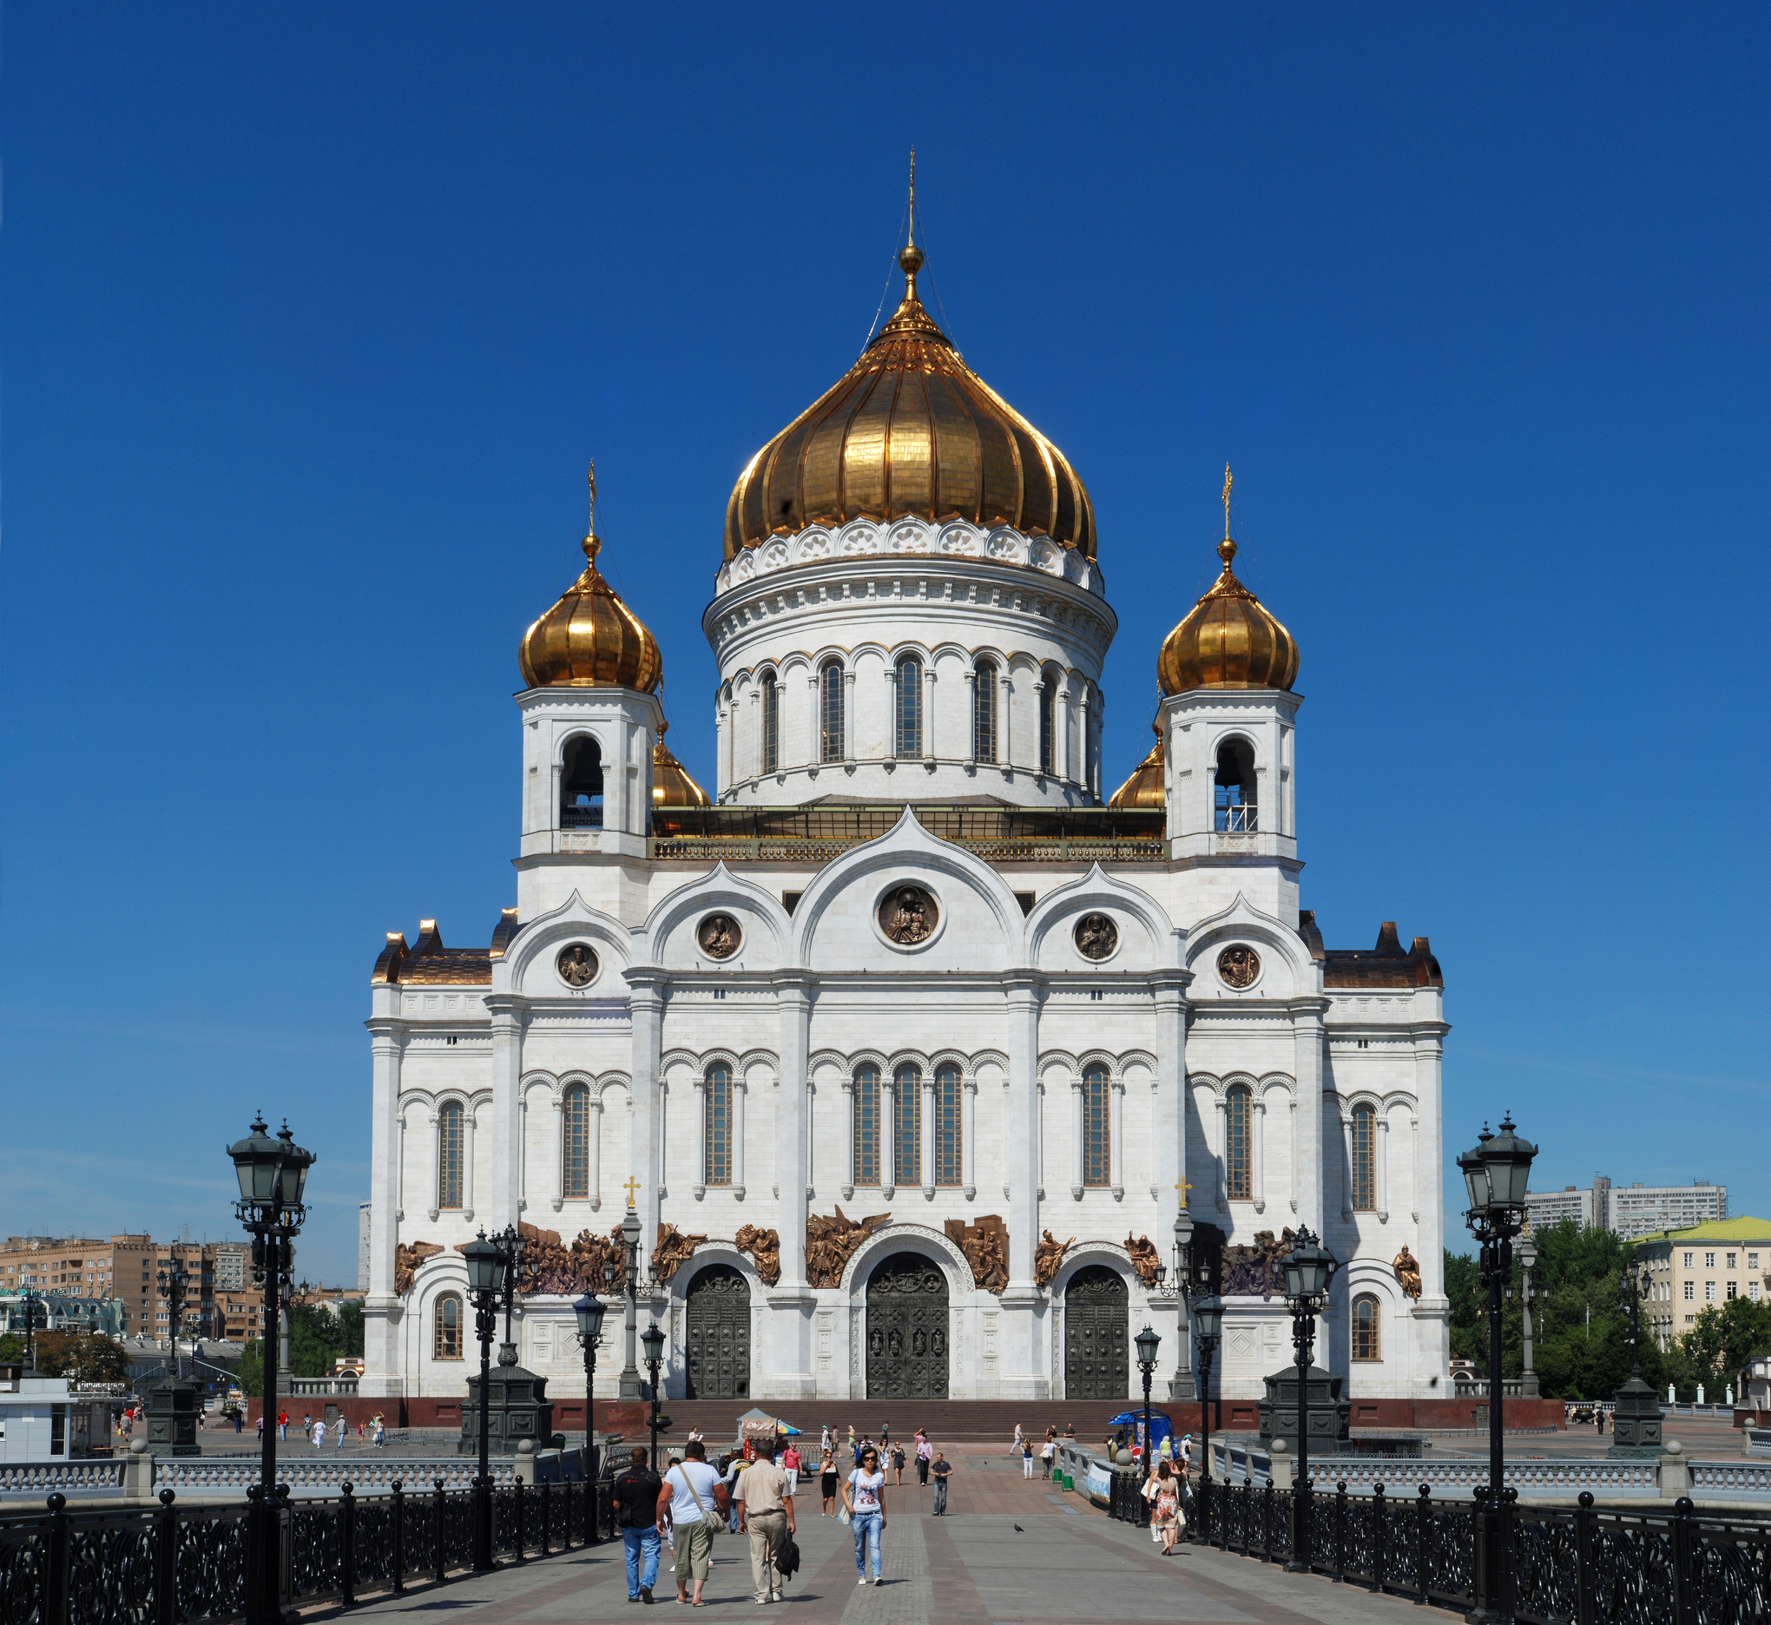
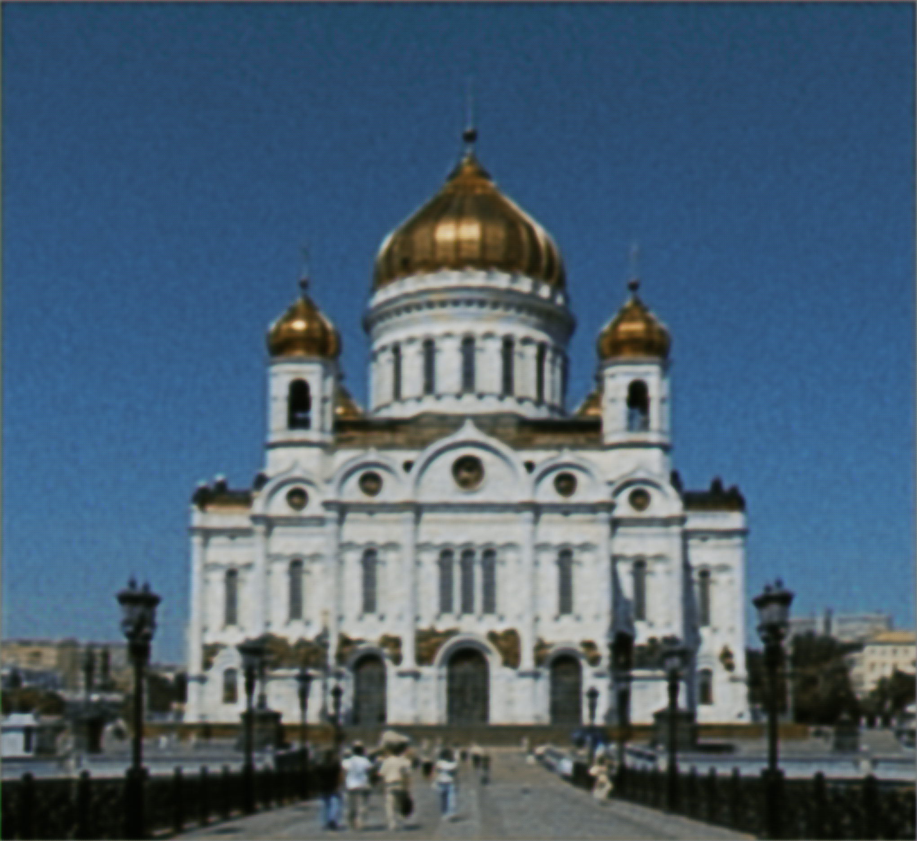
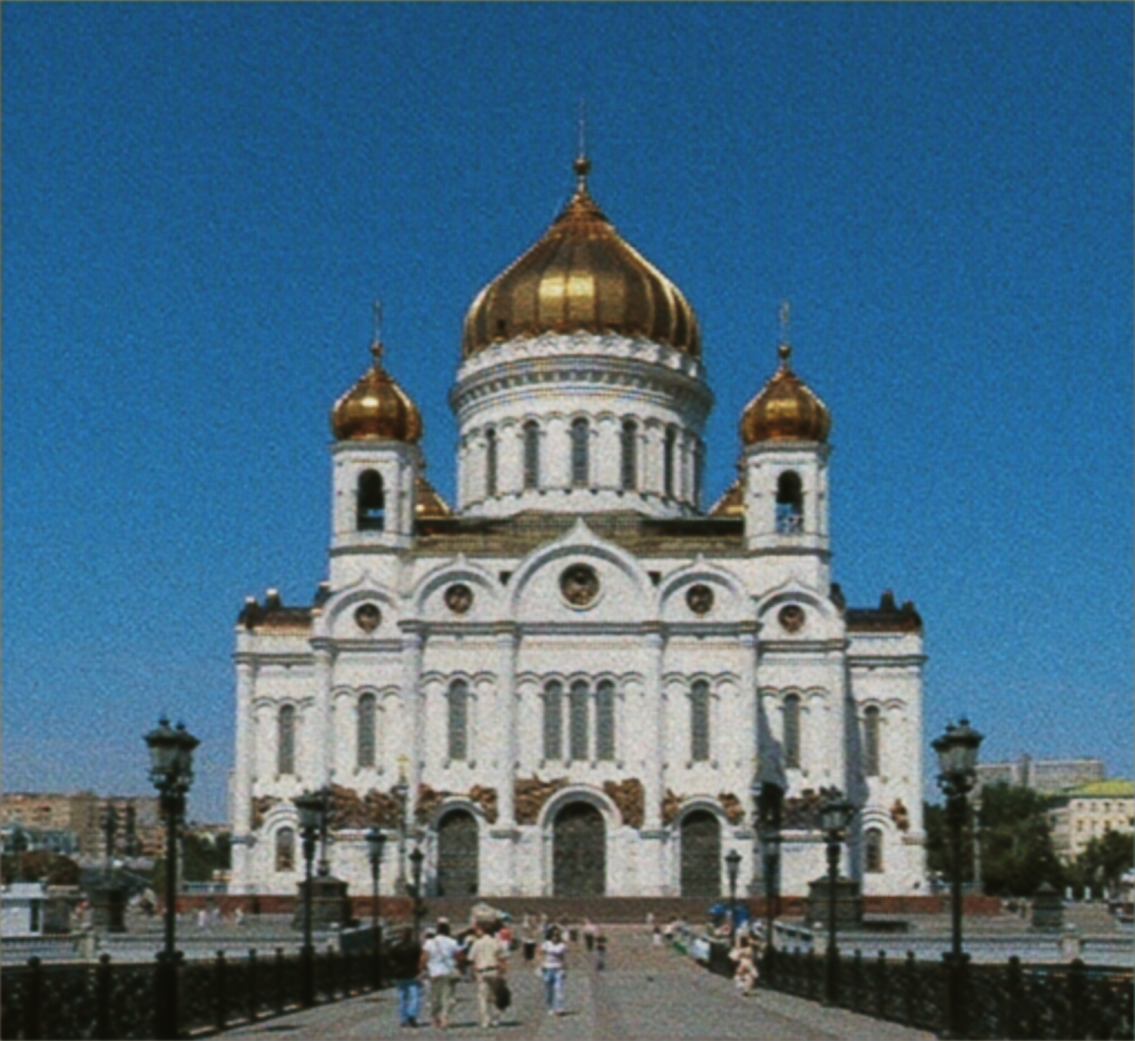

Results & Conclusion
 | SR-GAN | Fast SR-GAN | Modified Fast SR-GAN
PSNR (dB) | 28.36 | 29.10 | 28.89
SSIM | 0.37 | 0.61 | 0.632
Low Resolution Input
High Resolution
SR-GAN output
Fast SR-GAN output
Modified Fast SR-GAN output

Slide 7

Results & Conclusion
 | Bilinear | Pixel shuffle
PSNR (dB) | ﻿28.41 | 29.10
SSIM | 0.51 | 0.61
Bilinear Output
Low Resolution Input
High Resolution
Pixel shuffle Output

Slide 8
Results & Conclusion
Pixel shuffle up sampling output has high PSNR compared to Bilinear up sampling output
Modified Fast SR-GAN SSIM is better than both other models

